Slide 1


“K8S Storage Built-In”
Manage Storage Cluster for real-world
By Praparn Luengphoonlap
Email: praparn@opcellent.com

Slide 2
Agenda
Hyperconverged-infrastructure (HCI) for devops
Storage build-in solution for K8S ecosystem
All-in-One solution (One for all/All for one)
Architecture for
Demo: galera cluster for mariadb/wordpress
Case study: push notification system via kafka
Next roadmap for enhancement

Slide 3

Hyperconverged-Infrastructure (HCI) for DevOps

Slide 4
HCI for DevOps
The difference concept of Docker/K8S
Docker Native/Swarm Mode:
Simplify (Single command for initial/manage/maintain)
Provide all resource within suite (overlay network, key value etc) by default
Fastest deployment
K8S (Kubernetes):
Production grade orchestrator (Customizable)
Customize by design (network plugin, storage etc)
Complex configuration support for handle application

Slide 5
Highlight from DockerCon17 (EU)

Slide 6
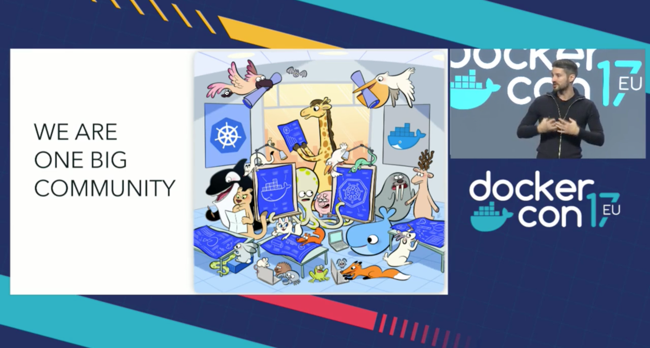
Highlight from DockerCon17 (EU)
“We are one big community”

Slide 7
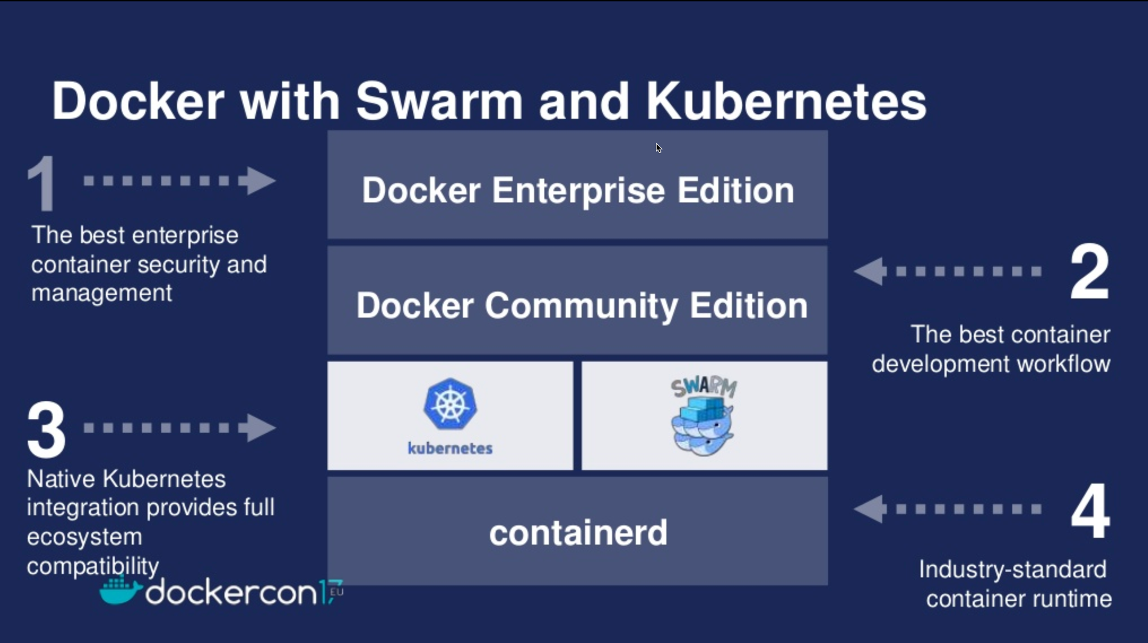
Highlight from DockerCon17 (EU)
Official support orchestrator both K8S and Swarm

Slide 8
Highlight from DockerCon17 (EU)

Slide 9
Highlight from DockerCon17 (EU)
The difference concept of Docker/K8S
Docker Native/Swarm Mode:
Simplify (Single command for initial/manage/maintain)
Provide all resource within suite (overlay network, key value etc) by default
Fastest deployment
K8S (Kubernetes):
Production grade orchestrator (Customizable)
Customize by design (network plugin, storage etc)
Complex configuration support for handle application

Slide 10
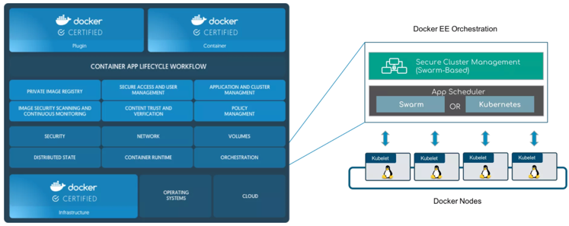
Highlight from DockerCon17 (EU)
Platform of docker to support K8S
Docker Enterprise Edition

Slide 11
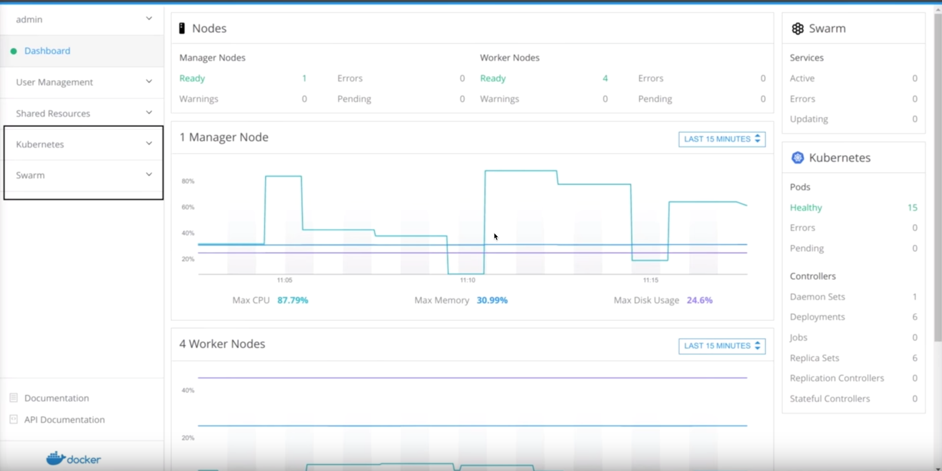
Highlight from DockerCon17 (EU)
Docker Enterprise Edition (EE)

Slide 12
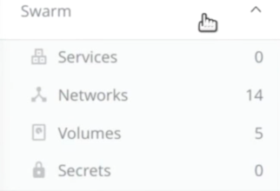
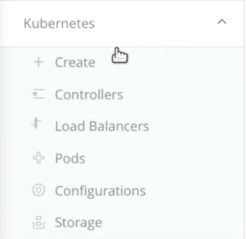
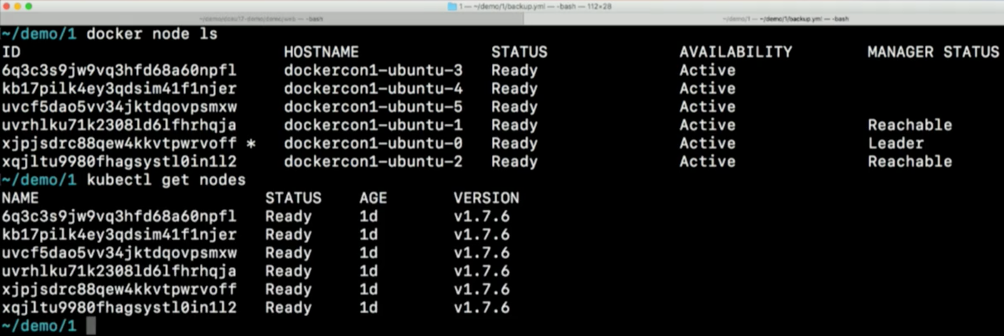
Highlight from DockerCon17 (EU)
Docker Enterprise Edition (EE)

Slide 13
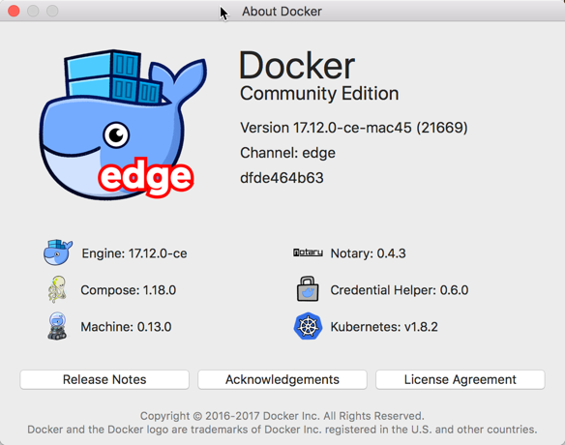
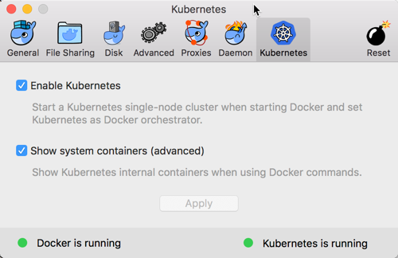
Highlight from DockerCon17 (EU)
Docker Community Edition (CE)
Docker for Windows
Docker for MAC (Available Now with Edge Edition !!!)

Slide 14
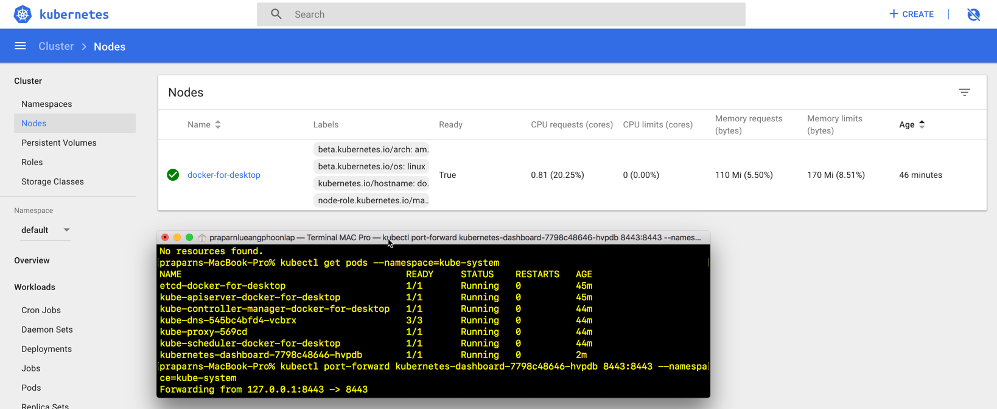
Highlight from DockerCon17 (EU)
Docker Community Edition (CE)
Docker for Windows
Docker for MAC (Available Now with Edge Edition !!!)

Slide 15
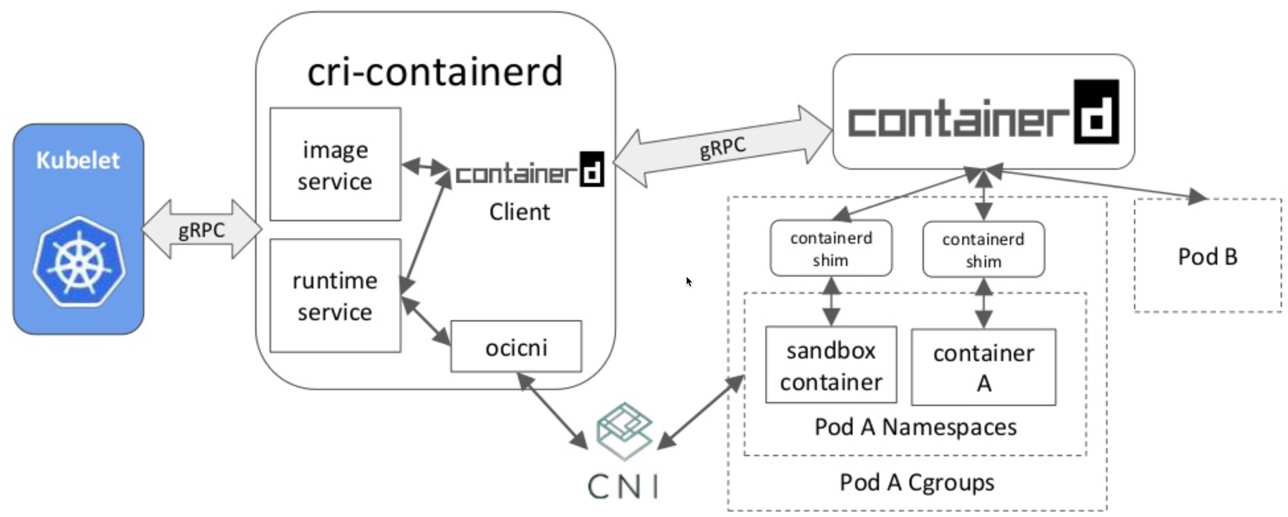

Highlight from DockerCon17 (EU)
Moby Project

Slide 16
Benefit of K8S in docker platform

Slide 17
Benefit of K8S in docker platform
Reduce complexity of K8S setup in this platform (Initial Farm, HA Setup etc)
Utilization host resource from mix workload for Swarm and K8S (Docker EE)
Developer feel free for testing both Swarm/K8S environment on their machine (Docker CE)
Multiple operate support in same farm
Docker native command (docker run, docker ps etc)
Kubernetest native command (kubectl create, kubectl get pods etc)
Compose support both orchestrator
Big community of sharing in container world

Slide 18
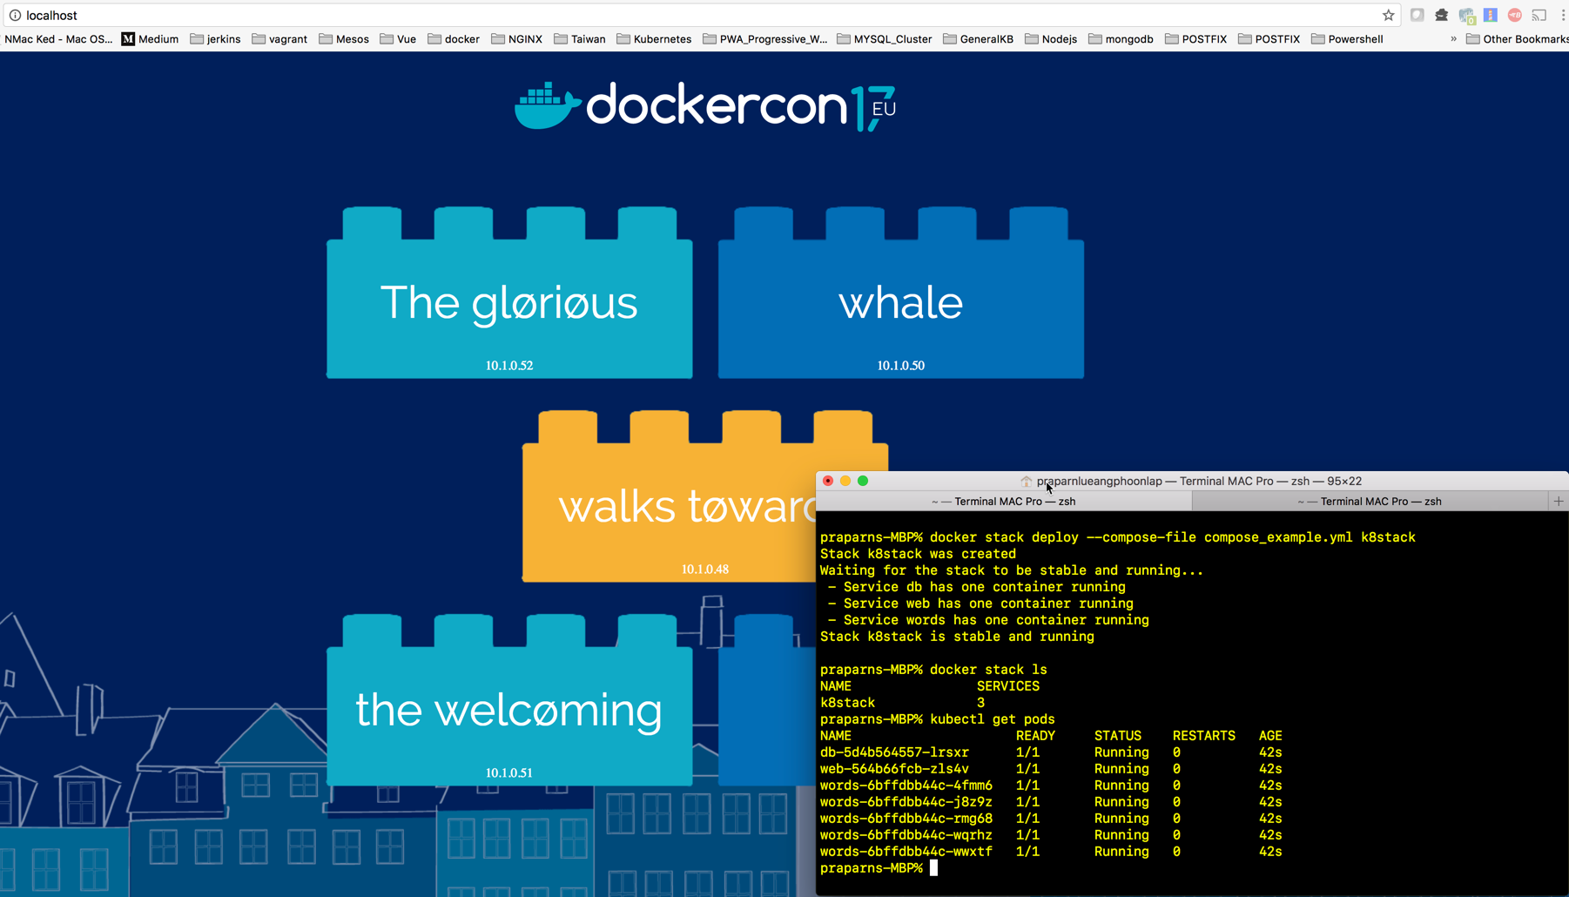
Benefit of K8S in docker platform

Slide 19
K8S vs Docker what is the difference ?

Slide 20
K8S vs Docker what is the difference ?
Topic | K8S | Docker/Swarm
Architecture | Open-system (Base on cluster manager ”Borg” for support complex workload) | Swarm: Proprietary of Docker product, “Easy to use”, “Extend capability of Docker in cluster”
Operation command | Almost operate by “YMAL” file (Declarative Command) | Almost operate by “command” (Imperative Command)
Unit of Work | Pods (Pods >= Container) | Container
How to Identify Work | “Label operation” | Docker: By container name Swarm: By service/stack name
Level of workload management | Service Level: (Simple) Replication Level: (Auto healing) Deployment Level: (Auto healing + Roll Update) | Docker: N/A Swarm: Service Level (Snag with service/stack)
Auto scaling | HPA (Horizontal Pods Scaling) base on CPU | No
Health check | Liveness & Readiness (Multi option to check application health) | Service health only

Slide 21
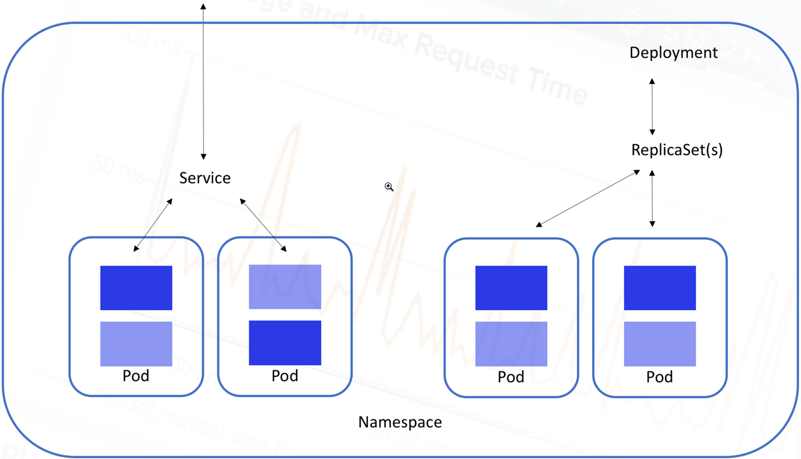
K8S vs Docker what is the difference ?
Workload Management
Swarm operation
docker service (run/ps/stop/rm etc)
docker stack (deploy/ls/ps/services etc)
K8S Operation
Service
Replication Controller
Deployment + RS

Slide 22
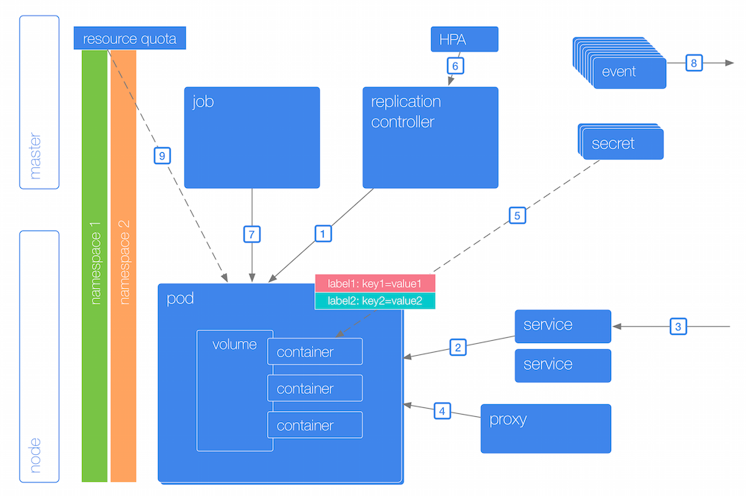
K8S vs Docker what is the difference ?
K8S Architecture
Docker Swarm Architcture

Slide 23
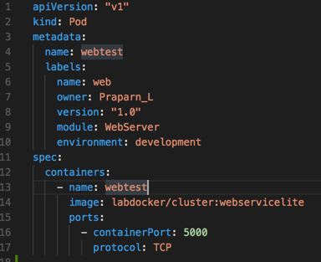
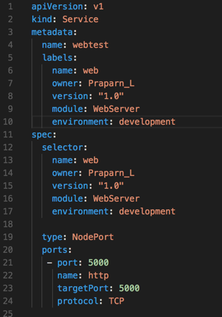
K8S vs Docker what is the difference ?
Docker Command
“docker container run -dt --name webtest -p 5000:5000 labdocker/cluster:webservicelite”
K8S Pods&Service (YAML File)

Slide 24
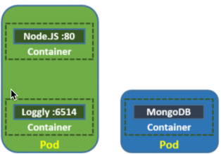
K8S vs Docker what is the difference ?
Unit of Work (Pods vs Container)
All container on same Pods will share:
Process ID (PID)
Network access (Communicate to each other via “localhost”)
Internal Process Command (IPC)
Unix Time-Sharing (UTS)
Hostname
IP Address/Ports
Use Case for Multiple Pods:
Apache (1 Container) +Tomcat (1 Container)
Apache(1 Container) + PHP (1 Container)
Nginx (Cache: 1 Container) + Apache/PHP (1 Container)
Web Server (1 Container) + Data Volume(Cache: 1 Container)
Pods will can create replicas of 1000+ set on cluster system

Slide 25
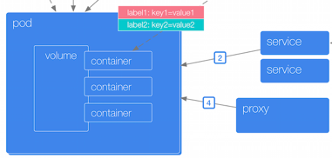
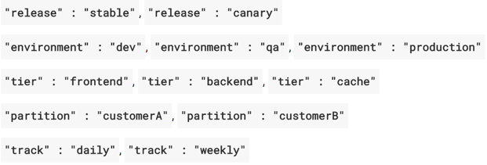
K8S vs Docker what is the difference ?
Identify Work (Label is base advantage of K8S)
All component of K8S will blinding with “label”
Label is free-form, Customize by yourself !!!

Slide 26
K8S vs Docker what is the difference ?
Workload Management
Swarm operation (Service/Stack)
docker service (run/ps/stop/rm etc)
docker stack (deploy/ls/ps/services etc)
K8S Operation
Service
Replication Controller
Deployment + RS

Slide 27
K8S vs Docker what is the difference ?
Auto Scale (K8S Horizontal Pod Autoscaler (HPA))

Slide 28

K8S vs Docker what is the difference ?
Health Check
Docker: monitor by service on container
Kubernetes: monitor by service + customize
Liveness: Pods/Container is still alive (if not restart pods)
Readiness Pods/Container is ready to use (if not redirect workload to another pods)
Technic for check (Both Liveness/Readiness):
ExecAction:
TCPSocketAction:
HTTPGetAction:

Slide 29
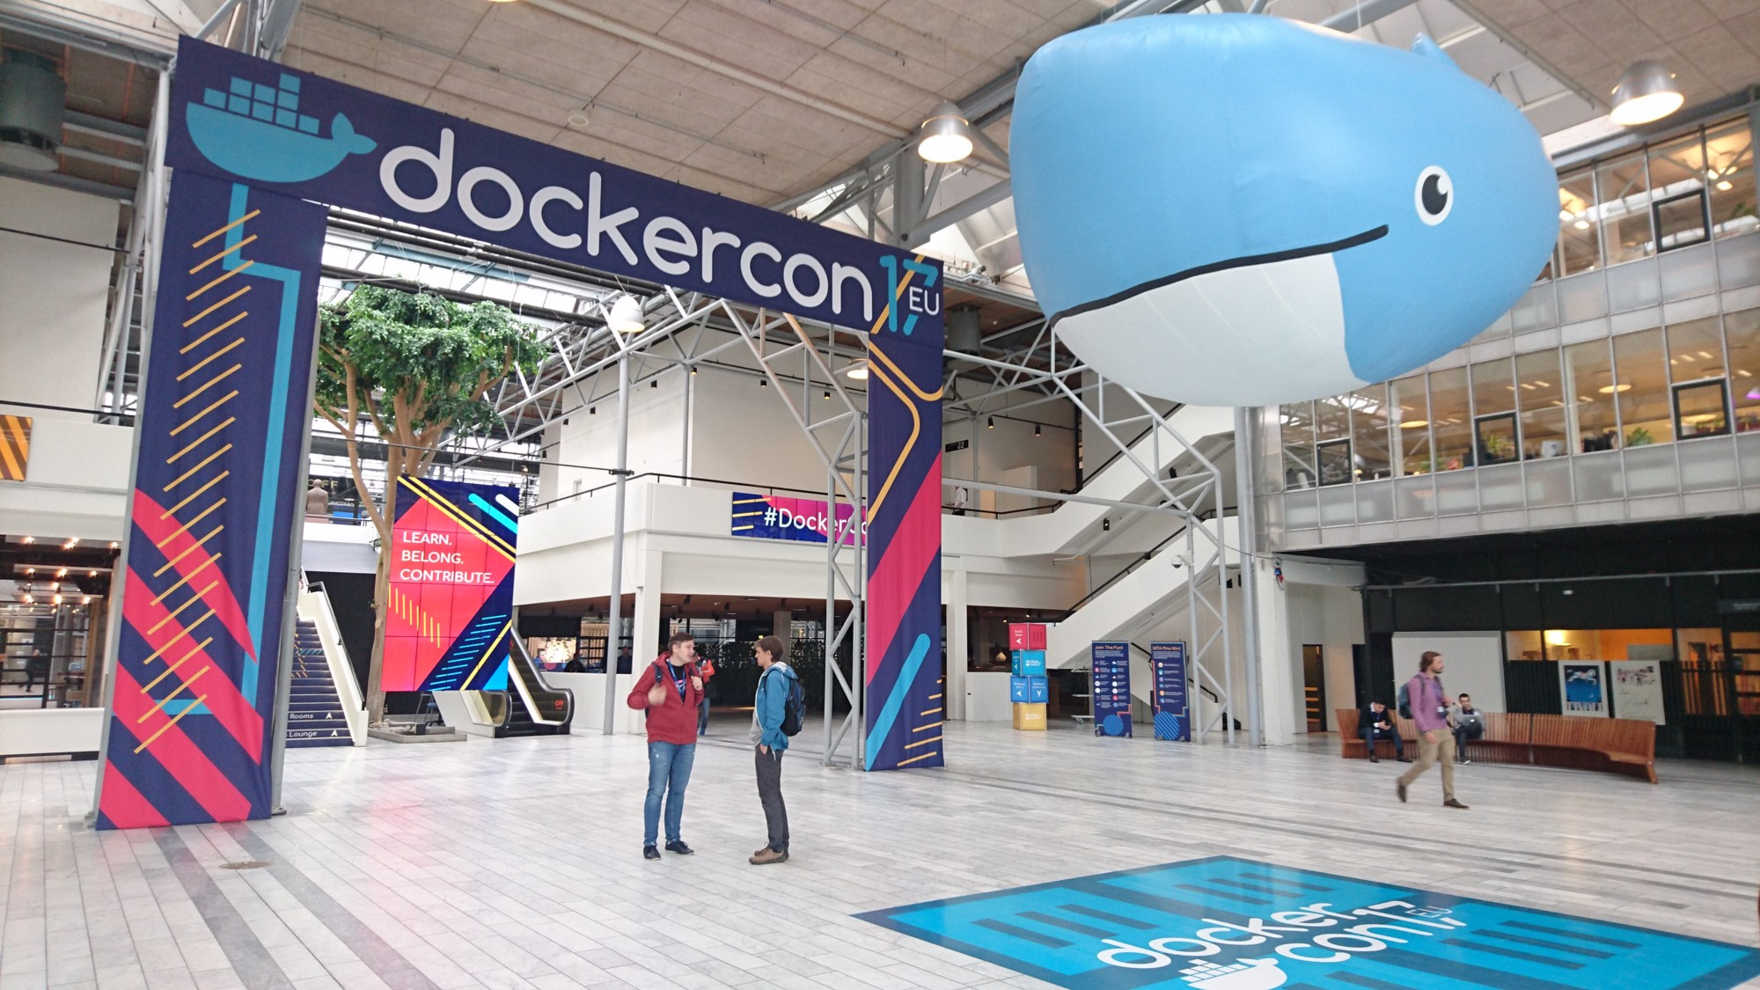
Demo Session

Slide 30
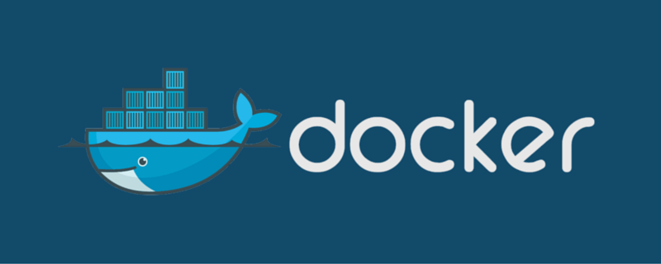
Q&A
By Praparn Luengphoonlap
Email: eva10409@gmail.com

